Slide 1
CSCI 3321 Client Server Web Programming
Lesson 2.1 - HTML

Slide 2

HTML Overview
HTML stands for HyperText Markup Language
Hypertext refers to links that connect web pages to one another, either within a single website or between websites.
HTML is the standard markup language for creating Web pages
It is not a programming language
It defines the meaning and structure of web content
It usually works with Cascading Style Sheets (CSS) and JavaScript
The current version is HTML5

Slide 3
HTML Elements
HTML elements are the building blocks of HTML pages
HTML elements are represented by <> tags
An HTML element is a start tag and an end tag with content in between
The name of an element inside a tag is case insensitive
For example, the <title> tag can be written as <Title>, <TITLE>, or in any other way

Slide 4
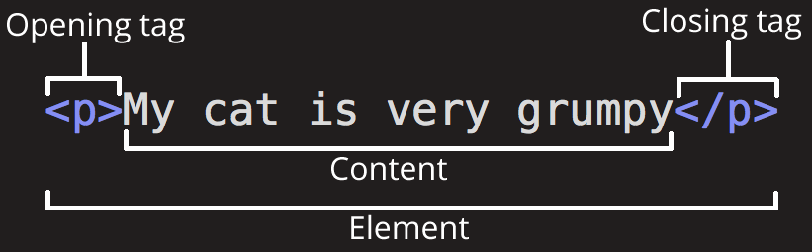
HTML Elements
/ indicates a closing tag or an end tag

Slide 5
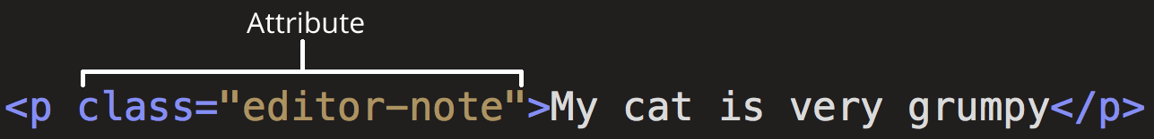
HTML Attributes
HTML elements can have attributes
Attributes provide additional information about the element but you don’t want them to appear in the actual content
Attributes come in name/value pairs
A space between it and the element name (or the previous attribute, if the element already has one or more attributes).
The attribute name followed by an equal sign.
The attribute value wrapped by opening and closing quotation marks.

Slide 6
HTML Elements
Nesting Elements
Elements can be put inside other elements: nesting
<p>My cat is <strong>very</strong> grumpy.</p>
Empty Elements
Some elements have no content and are called empty elements.
<img src="images/firefox-icon.png" alt="My test image">

Slide 7
HTML Elements
Commonly Used HTML Elements
<head>, <title>, <body>, <header>, <footer>, <article>, <section>, <p>, <a>, <div>, <span>, <img>, <aside>, <audio>, <canvas>, <datalist>, <details>, <embed>, <nav>, <output>, <progress>, <video>, <ul>, <ol>, <li>, <table>
Visit https://www.w3schools.com/tags/ to learn what each element means
Most of the HTML elements are self-explanatory

Slide 8
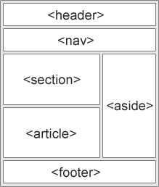
Semantic Elements
A Semantic Element is one that clearly describes its meaning to both the browser and to the developer
<header>, <footer>, <article>, <section>, <aside>, <audio>, <canvas>, <datalist>, <details>, <embed>, <nav>, <video>

Slide 9
HTML Document
A text file that contains HTML elements
The file name usually has an extension of .html or .htm
All HTML documents must start with a document type declaration: <!DOCTYPE html> on the very top of the document
After the document type declaration, the HTML document begins with <html> and ends with </html>
All other elements will be put inside <html> and </html>

Slide 10
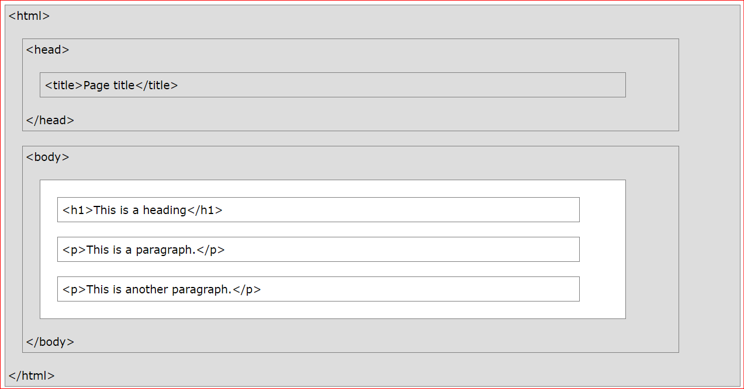
HTML Document Structure
An HTML document is usually called an HTML page in a browser
Here is a visualization of an HTML page

Slide 11
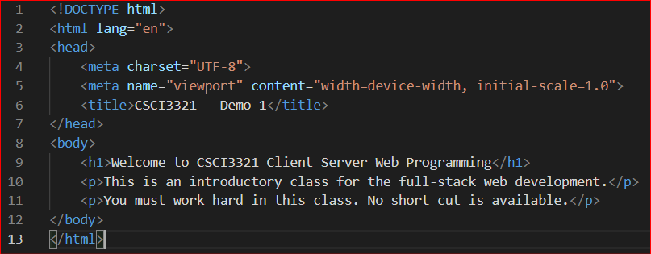
HTML Document Structure
Example

Slide 12
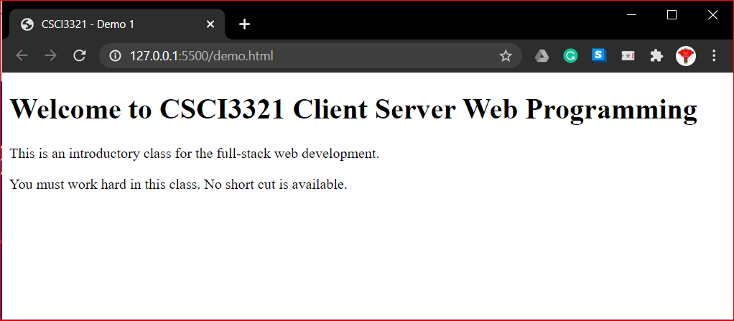
HTML Document Structure
Example
<title>
<h1>
<p>

Slide 13
HTML Document Structure
Example Explained
The <!DOCTYPE html> declaration defines this document to be HTML5
The <html> element is the root element of an HTML page
The lang attribute defines the language of the document
The <meta> element contains meta information about the document
The charset attribute defines the character set used in the document
The <title> element specifies a title for the document
The <body> element contains the visible page content
The <h1> element defines a large heading
The <p> element defines a paragraph
Only the content inside the <body> section is displayed in a browser.

Slide 14
HTML Element Attributes - Revisited
Each element can have attributes
For this class, you need to know the following attributes:
id
class
style
src, alt, width, height
href
title
onclick
onmouseover
https://www.w3schools.com/tags/ref_attributes.asp

Slide 15

The id Attribute
Specify a unique id for an HTML element
The value of the id attribute must be unique within the HTML document
The id attribute is used to point to a specific style declaration in a style sheet
It is also used by JavaScript to access and manipulate the element with the specific id

Slide 16

The class Attribute
Specifies one or more classnames for an element
Is used to point to a class in a style sheet
Is used by a JavaScript (via the HTML DOM) to make changes to HTML elements with a specified class

Slide 17
The style Attribute
The style attribute specifies an inline style for an element
The style attribute will override any style set globally, e.g. styles specified in the <style> tag or in an external style sheet.
https://www.w3schools.com/tags/tryit.asp?filename=tryhtml5_global_style

Slide 18
The src, alt, width, height Attribute
For <img> elements
src: the location of the image
alt: provides alternative information for an image if a user for some reason cannot view it (because of slow connection, an error in the src attribute, or if the user uses a screen reader). Required for the <img> element
width: the width of the image in pixels
height: the height of the image in pixels

Slide 19

The href Attribute
For <a> elements
The URL of the page the link goes to
For <link> elements
The location (URL) of the external resource (most often a style sheet file)
Can be an absolute URL or an relative URL

Slide 20
The title Attribute
Specify extra information about an element
The information is shown as a tooltip text when the mouse moves over the element

Slide 21
The onclick, onmouseover Attributes
The onclick attribute fires on a mouse click on the element
The onmousemove attribute fires when the pointer is hovering over an element
They belong to the Event attributes (we will cover “Event” in JavaScript lesson)

Slide 22
HTML Element Attributes - Revisited
Some elements must have certain attributes in order to work properly:
<img src=“http://www.sfasu.edu/themes/custom/sfa/css/images/logo.png” alt=“SFA Logo”>
<a href=“http://www.sfasu.edu/about-sfa”>About SFA</a>
Always use lowercase attribute names
Always quote attribute values with single quotes or double quotes

Slide 23
Basic HTML Elements for Marking up Text
HTML Heading
<h1> to <h6> tags (click here to try)
<h1>: the most important heading
<h6>: the least important heading
HTML Paragraphs
<p> tags (click here to try)
HTML Links
<a> tags (click here to try)
HTML Images
<img> tags (click here to try)
HTML Lists
<ul> (unordered/bullet list) or <ol> (ordered/numbered list) tags, followed by <li> tags (list items) (click here to try)

Slide 24
Basic HTML Elements for Marking up Text
HTML Buttons
<button> tags (click here to try)
Similar to <input type=“button”> tags (see later slide)
HTML Tables
An HTML table is defined with a <table> tag
Table rows: <tr> tags
Table headers: <th> tags
Table cells (data): <td> tags
Click here to try

Slide 25
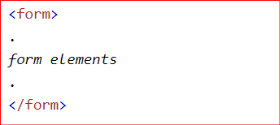
HTML Form
HTML Form
The HTML <form> element is used to create an HTML form for user input
The <form> element is a container for different types of input elements, such as: text fields, checkboxes, radio buttons, submit buttons, etc.

Slide 26
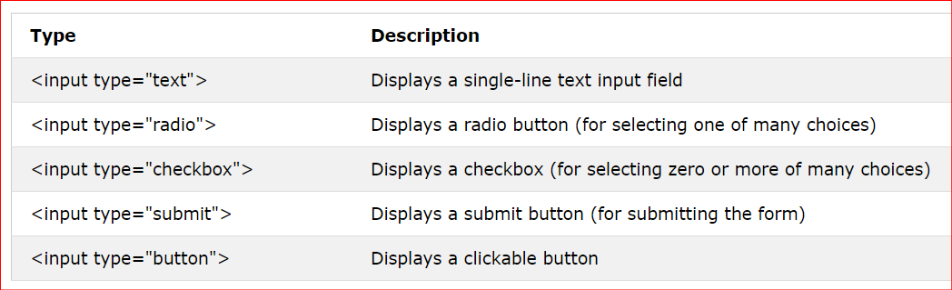
<input> Elements

Slide 27
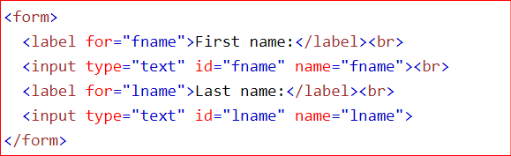
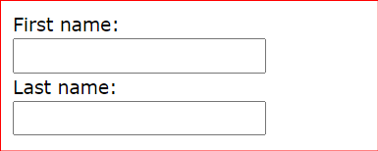
Text Fields (textboxes)
The <input type="text"> defines a single-line input field for text input.

Slide 28
<label> Element
The <label> tag defines a label for many form elements
The <label> element is useful for screen-reader users, because the screen-reader will read out loud the label when the user focus on the input element - accessibility
The for attribute of the <label> tag should be equal to the id attribute of the <input> element to bind them together

Slide 29
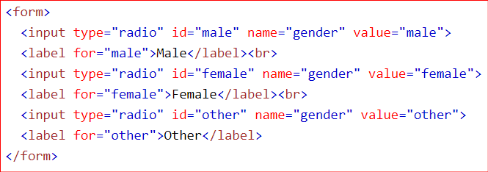
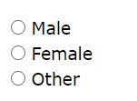
Radio Buttons
The <input type="radio"> defines a radio button
Let a user select ONE of a limited number of choices: single choice
The name attribute groups radio buttons together

Slide 30
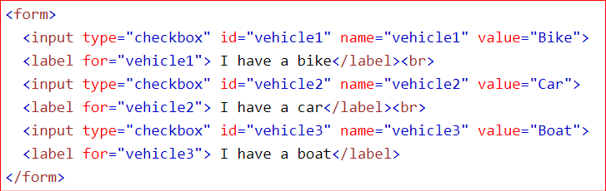
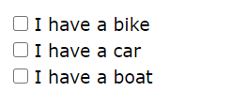
Checkboxes
The <input type="checkbox"> defines a checkbox
Let a user select ZERO or MORE options of a limited number of choices

Slide 31
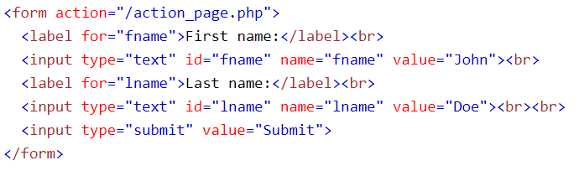
Submit Button
The <input type="submit"> defines a button for submitting the form data to a form-handler
The form-handler is typically a file on the server with a script for processing input data
The form-handler is specified in the form's action attribute.

Slide 32
<button> vs. <input type=“submit”>
Buttons created with the <button> element function just like buttons created with the <input> element, but they offer richer rendering possibilities: the <button> element may have content. For example, a <button> element that contains an image functions like and may resemble an <input> element whose type is set to “image”, but the <button> element type allows content.
<button> element inside a <form> element will implicitly submit the form when it is clicked

Slide 33
HTML Block and Inline Elements

Slide 34
HTML Block and Inline Elements
HTML elements can be categorized into two types according to how the elements are displayed in a browser
Block elements
Inline elements

Slide 35
Block Elements
A block element always starts on a new line and takes up the full width available (stretches out to the left and right as far as it can).
List of the block elements
<address>, <article>, <aside>, <blockquote>, <div>, <footer>, <form>, <h1>-<h6>, <header>, <hr>, <li>, <main>, <nav>, <ol>, <p>, <section>, <table>, <ul>
https://www.w3schools.com/html/tryit.asp?filename=tryhtml_block_div

Slide 36
Inline Elements
An inline element does not start on a new line and it only takes up as much width as necessary.
List of the inline elements
<a>, <abbr>, <b>, <br>, <button>, <code>, <em>, <i>, <img>, <input>, <label>, <map>, <object>, <script>, <select>, <span>, <strong>, <sub>, <sup>, <textarea>
https://www.w3schools.com/html/tryit.asp?filename=tryhtml_inline_span

Slide 37

HTML Comments
Do not show up in the browser
Help document your HTML source code
Syntax:

Slide 38
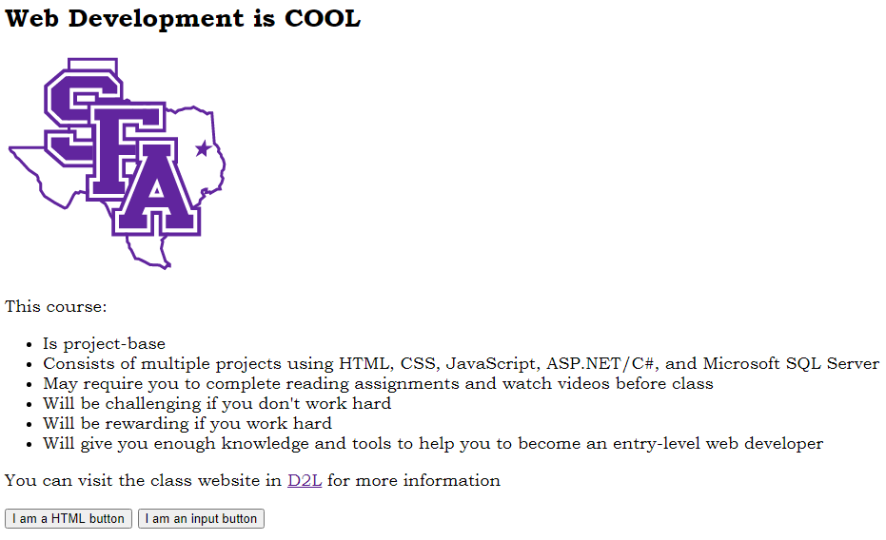
Project - your first web page
Go to Tryit Editor v3.6
Use the HTML elements you have learned so far to modify the page so that it will be like the one on the left (you must click RUN after you change anything)
The link to the SFA logo is http://www.sfasu.edu/themes/custom/sfa/css/images/logo.png
The link to D2L: http://mysfa.sfasu.edu

Slide 39
Project - your first web page
Tasks
Change the background color of the page to SFA official color: #61249d
Change the font color to white (#ffffff)
Decrease the heading to the level 2
Change the heading text to “Welcome to CSCI3321 Client Server Web Programing”
Reduce the size of the SFA logo to be 100 pixels wide and 100 pixels high
Add a new paragraph after the text “You can visit the class website…” to include the following information:
Your name
Your classification
Your college/department
Change the background color, font face, and font size of the two buttons to your own preference

Slide 40
Project - your first web page
Submit your project
launch Inspect in Chrome
Resize the width of the Tryit Editor window by resizing the Inspect window. Make sure the width of the Tryit Editor is 550 pixels and the height is high enough to include all the web content
Make a screenshot of the Tryit Editor that includes both the HTML panel and the actual web page panel
Turn in the screenshot in D2L

